Slide 1
TEAM 6
Heart Disease Prediction Model
Hari Priya Avarampalayam Manoharan
Agash Sekar
Rida Fathima

Slide 2
Motivation & Problem

Slide 3
Problem Statement
To predict the Heart Disease of patients using Machine Learning Algorithms

Slide 4
Proposed Solution
Build Classification Models to Predict the Heart Disease of Patients

Slide 5
Dataset Description
Dataset = https://www.kaggle.com/datasets/themrityunjaypathak/heart-disease-and-stroke-*prevention*

Slide 6
Dataset
The dataset has 39,712 rows with 36 columns
Heart Failure
16,467
Coronary Heart Disease
4,669
Stroke
4,658
Classes
Major Cardiovascular Disease
4,657
Other Heart Disease
4,644
Heart Attack
4,617

Slide 7
Data Preparation

Slide 8
Data Cleaning
Dropped columns which have more than 60% Null Values
Normalized by taking the square root.
Higher Outlier = Q3+(1.5*IQR)
Removed Outliers
The outliers from Data_Value, LowConfidenceLimit, HighConfidenceLimit are dropped using the below formula.
Lower Outlier = Q1 - (1.5*IQR)

Slide 9
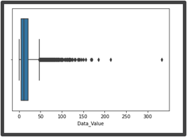
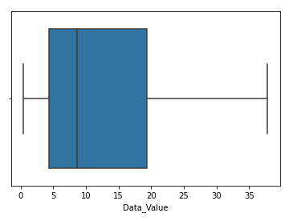
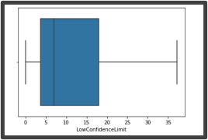
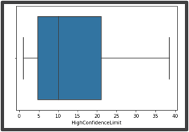
Outlier Removal

Slide 10
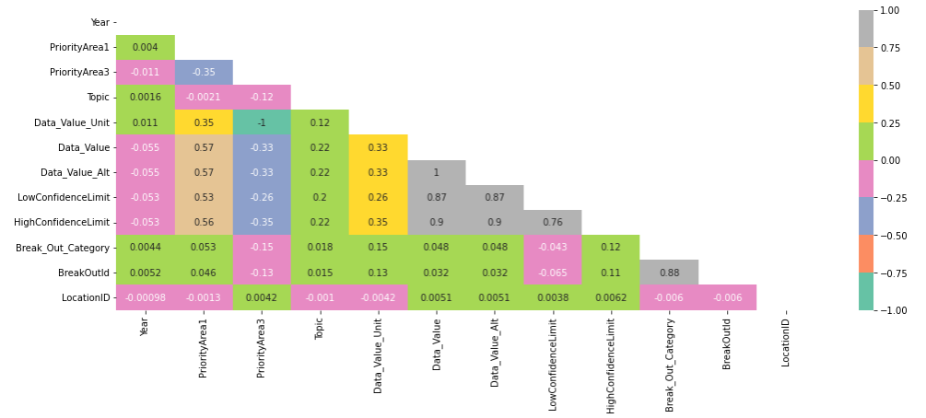
Correlation

Slide 11
Feature Selection

Slide 12
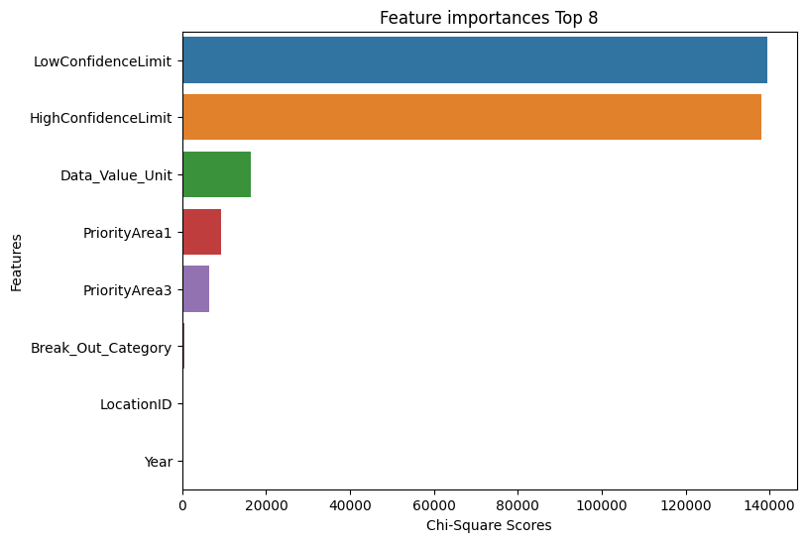
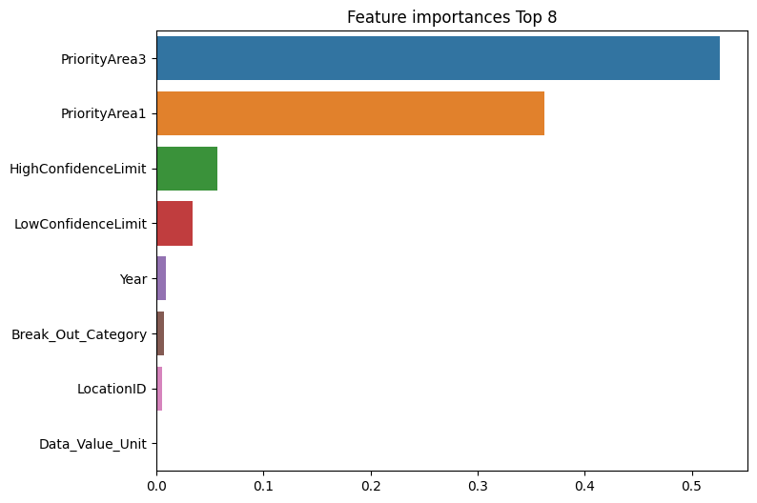
Feature Selection – Chi Square & XGB

Slide 13
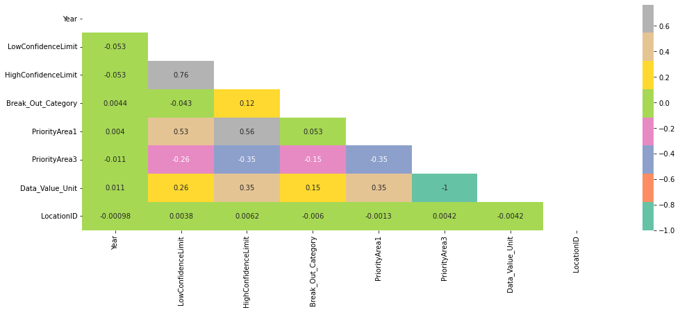
Correlation - (Top 8 Features)

Slide 14
Exploratory Data Analysis

Slide 15
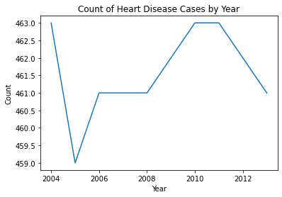
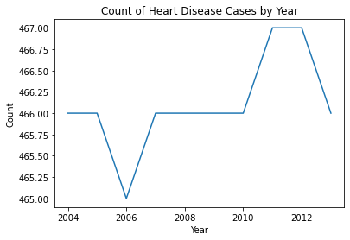
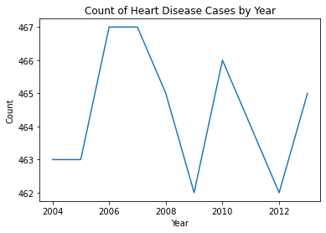
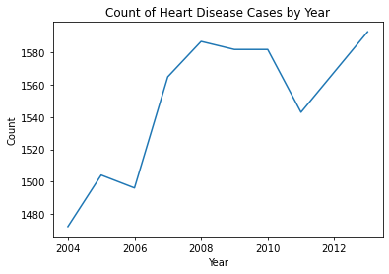
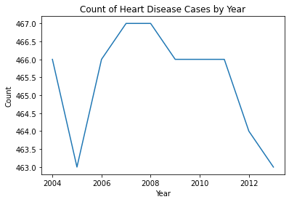
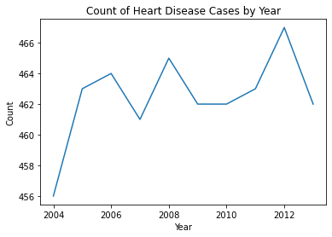
Trend of Heart Diseases
Heart Attack
Stroke
Other
Heart Failure
Major CV
Coronary HD

Slide 16
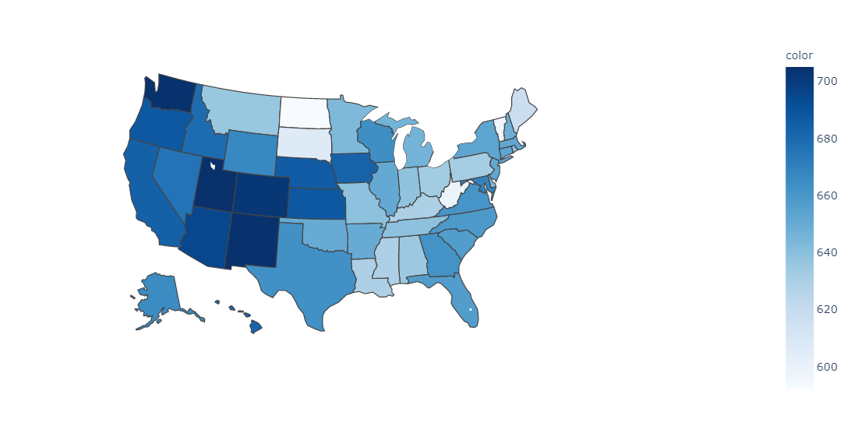
Heart Disease – State Analysis
Washington
California
Colorado

Slide 17
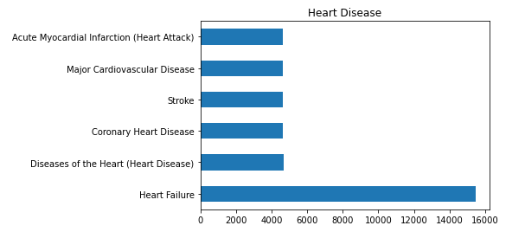
Target Distribution

Slide 18
Modeling

Slide 19
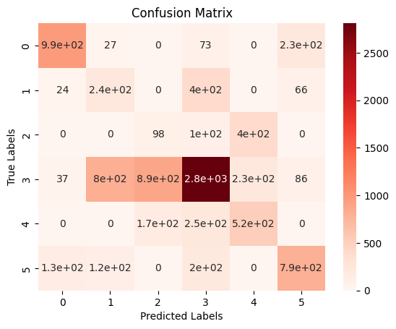
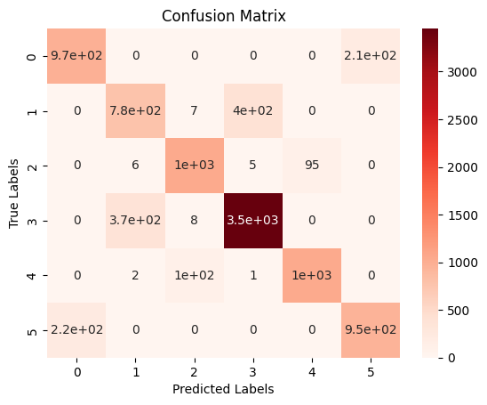
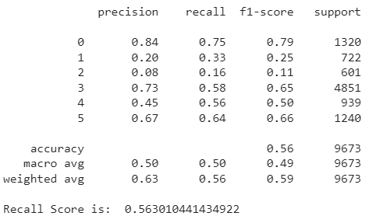
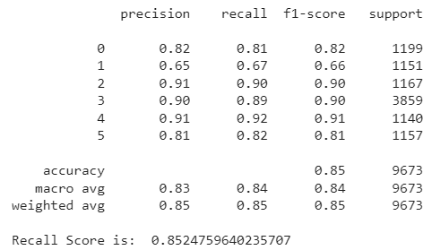
Models without Sampling
Logistic Regression
Decision Tree

Slide 20
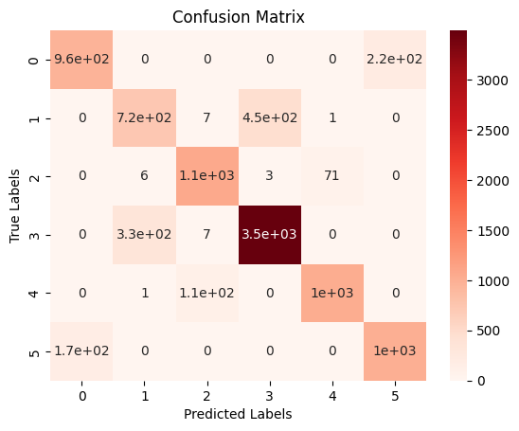
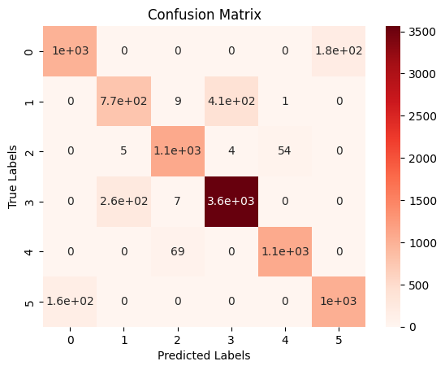
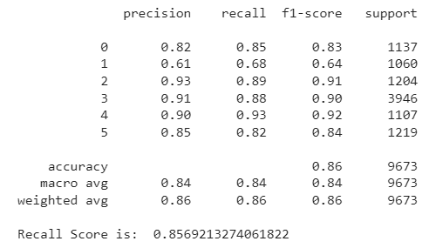
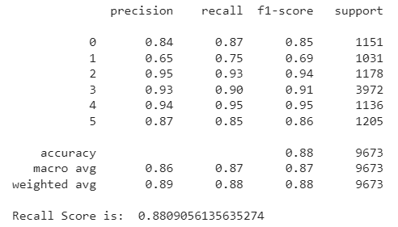
Models without Sampling
Random Forest
XGB Classifier

Slide 21
Under Sampling

Slide 22
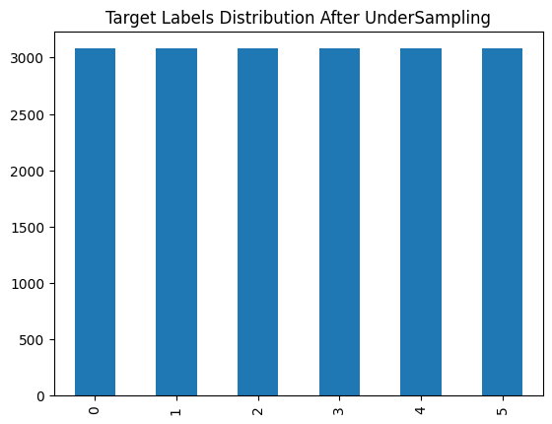
Under sampling
Original Dataset Shape: (38692, 8)
Dataset Shape: (18474, 8)
0 - Heart Attack
1 - Coronary Heart Disease
2 - Other Heart Diseases
3 - Heart Failure
4 - Major Cardiovascular Disease
5 - Stroke

Slide 23
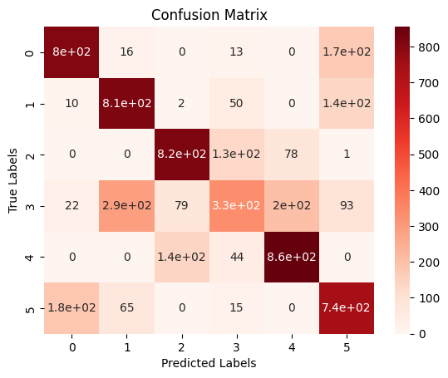
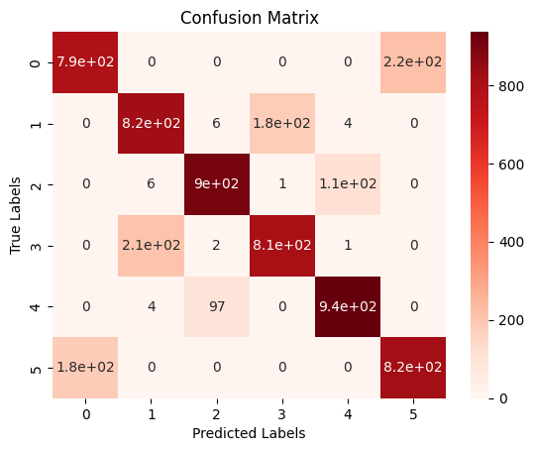
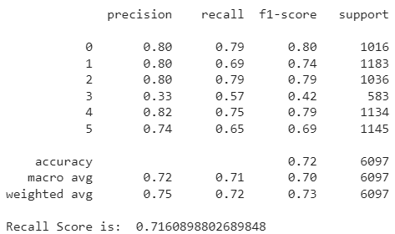
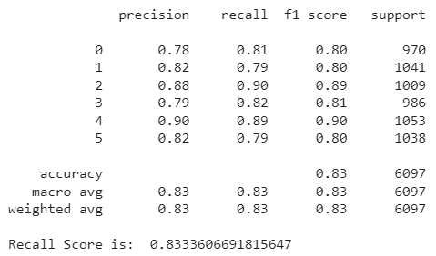
Models
Logistic Regression
Decision Tree

Slide 24
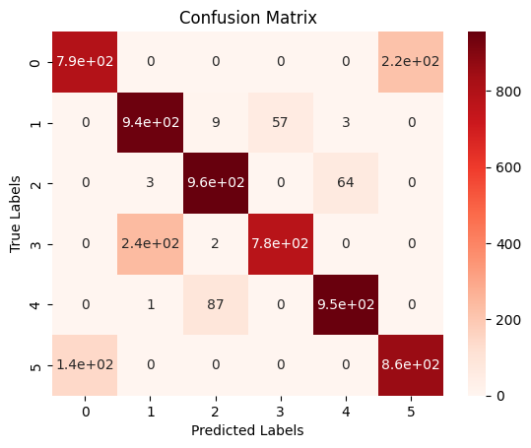
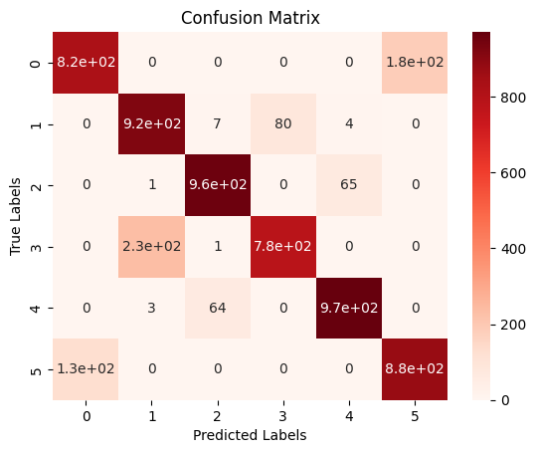
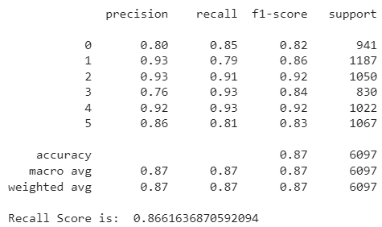
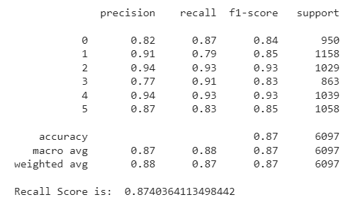
Models
Random Forest
XGB Classification

Slide 25
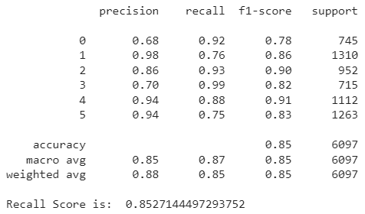
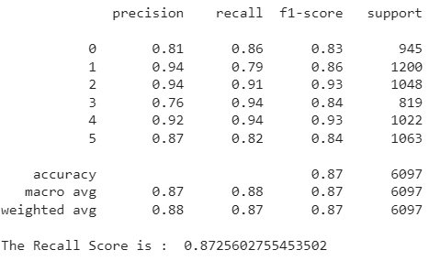
Under Sampling with Hyperparameters
Decision Tree
Random Forest
Best parameters:
'max_depth': 6, 'min_samples_leaf': 8, 'min_samples_split': 2
Best parameters:
'max_features': 0.5, 'min_samples_leaf': 2, 'min_samples_split': 5, 'n_estimators': 100

Slide 26
Over Sampling

Slide 27
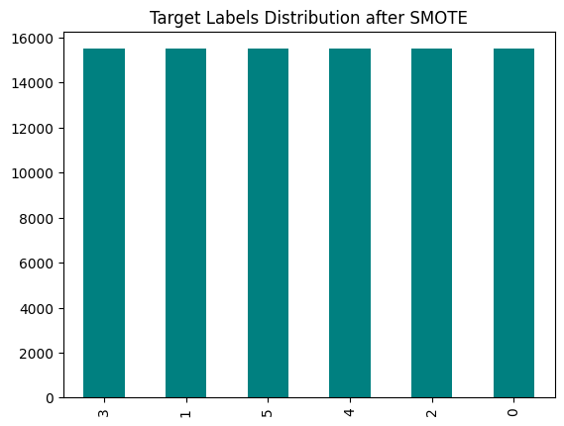
SMOTE
Original Dataset Shape: (38692, 8)
SMOTE Dataset Shape: (92952, 8)
0 - Heart Attack
1 - Coronary Heart Disease
2 - Other Heart Diseases
3 - Heart Failure
4 - Major Cardiovascular Disease
5 - Stroke

Slide 28
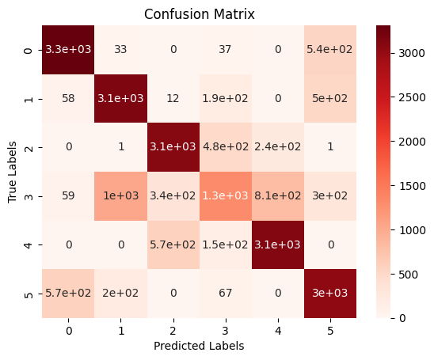
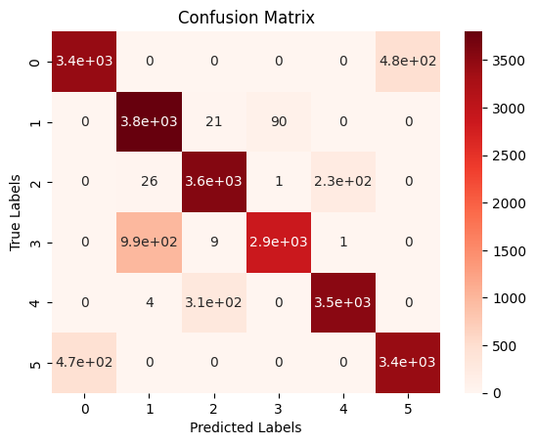
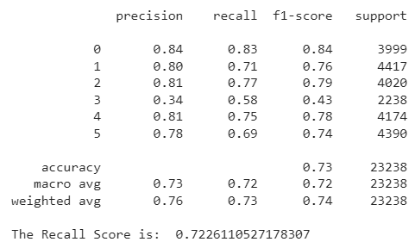
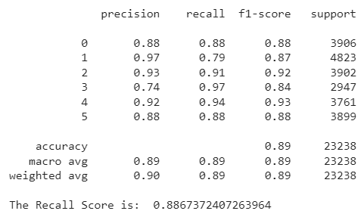
After SMOTE
Logistic Regression
Decision Tree

Slide 29
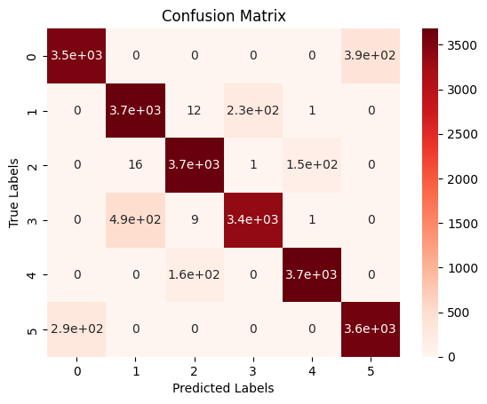
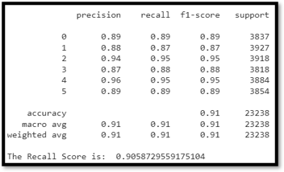
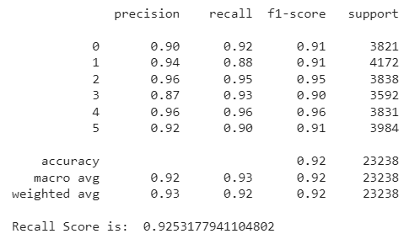
After SMOTE
Random Forest
XGB Classification

Slide 30

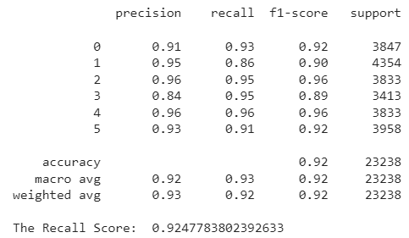
SMOTE with Hyperparameters
Decision Tree
Random Forest
Best Parameters:
'max_depth': 10,
'min_samples_leaf': 2,
'min_samples_split': 2
Best parameters:
'max_features': 0.5, 'min_samples_leaf': 2, 'min_samples_split': 2, 'n_estimators': 500

Slide 31
Result

Slide 32
Results
MODELS | NO SAMPLING | UNDER SAMPLING | OVERSAMPLING
LOGISTIC REGRESSION RECALL | 56% | 71% | 72.26%
DECISION TREE RECALL | 85.24% | 83.33% | 88.67%
DECISION TREE RECALL (Tuning) | - | 85.27% | 89.43%
RANDOM FOREST RECALL | 85.69% | 86.61% | 90.58%
RANDOM FOREST RECALL (Tuning) | - | 87.25% | 92.47%
XGBOOST RECALL | 88.09% | 87.40% | 92.53%

Slide 33
Thank You

